Slide 1
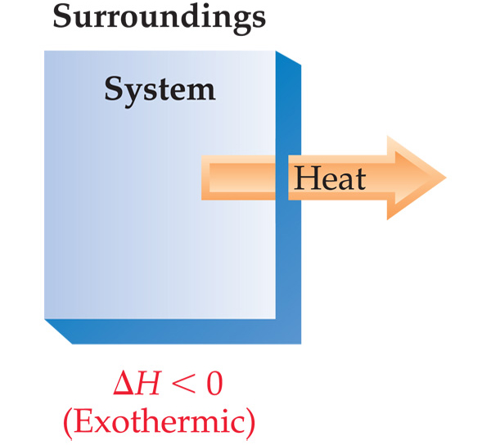
Exothermic
When heat is released (given off) by the system into the surroundings, the process is exothermic
ΔH = H_{final} − H_{initial}
ΔH = H_{products} − H_{reactants}
ΔH = negative value
for exothermic

Slide 2
Enthalpy of Reaction
This quantity, ΔH, is called the enthalpy of reaction, or the heat of reaction.
Enthalpy is an extensive property.
Reverse Rx → Negate ΔH value.
Phase (state) matters.

Slide 3
Enthalpies of Formation
An enthalpy of formation, ΔH_{f}, is defined as the enthalpy change for the reaction in which a compound is made from its constituent elements in their elemental forms.
Example:
2 Al (s) + 3 O₂ (g) → 2 Al₂O₃ (s)
ΔH_{f} = -3340 kJ

Slide 4
Standard Enthalpies of Formation
Standard enthalpies of formation, ΔH_{f}°, is defined as the enthalpy change for the reaction in which one mole of a compound is made from its constituent elements in their standard states at 25º C (298 K) and 1.00 atm pressure.
Example:
2 Al (s) + 3/2 O₂ (g) → Al₂O₃ (s)
ΔH_{f}°= - 1670 kJ/mol

Slide 5
Calculation of ΔH
ΔH = Σ n ΔH_{f}°_{products} – Σ m ΔH_{f}° _{reactants}
where n and m are the coefficients.
ΔH_{f}°Values are listed in Appendix C of your Textbook.

Slide 6
Calculation of ΔH
C₃H_{8 (g)} + 5 O_{2 (g)} ⎯→ 3 CO_{2 (g)} + 4 H₂O _{(l)}
ΔH = [3(-393.5 kJ) + 4(-285.8 kJ)] – [1(-103.85 kJ) + 5(0 kJ)]
= [(-1180.5 kJ) + (-1143.2 kJ)] – [(-103.85 kJ) + (0 kJ)]
= (-2323.7 kJ) – (-103.85 kJ) = -2219.9 kJ
ΔH = Σ n ΔH_{f} _{products} – Σ m ΔH_{f}° _{reactants}

Slide 7
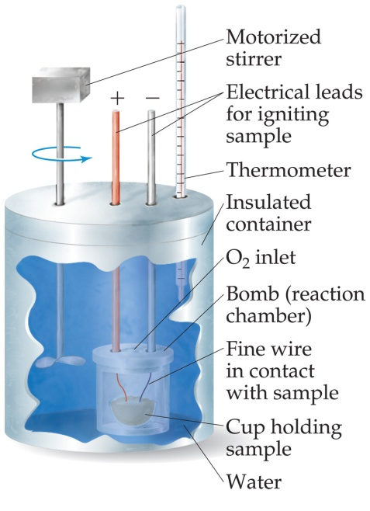
Calorimetry is Another Way to Measure ΔH values
We measure ΔH through calorimetry, which measures heat flow.
But first, some definitions.

Slide 8
Heat Capacity
The amount of energy (joules) required to raise the temperature of a substance by 1 K (1°C) is its heat capacity. Units are J/K or J/ °C
q = C * ΔT or C = q / ΔT
q = heat in Joules
C = heat capacity in J/K
ΔT = change in temperature

Slide 9
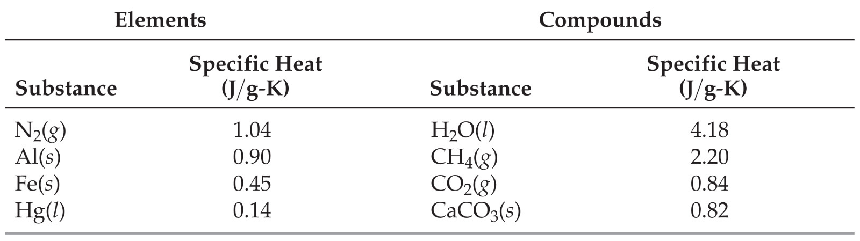
Specific Heat
Specific heat capacity (or simply specific heat) is the amount of energy (joules) required to raise the temperature of 1 g of a substance by 1 K. Units are J/g-K

Slide 10
Molar Heat Capacity
Molar heat capacity is the amount of energy (joules) required to raise the temperature of 1 mole of a substance by 1 K. Units are J/mol-K
Also helpful: # mol = mass/gfm

Slide 11
Use Units
What is the molar heat capacity of CH₄ (g) if its specific heat capacity is 2.20 J/g-K?
Answer:
2.20 J x 16.0 g =
g – K 1 mol
35.2 J/mol-K

Slide 12
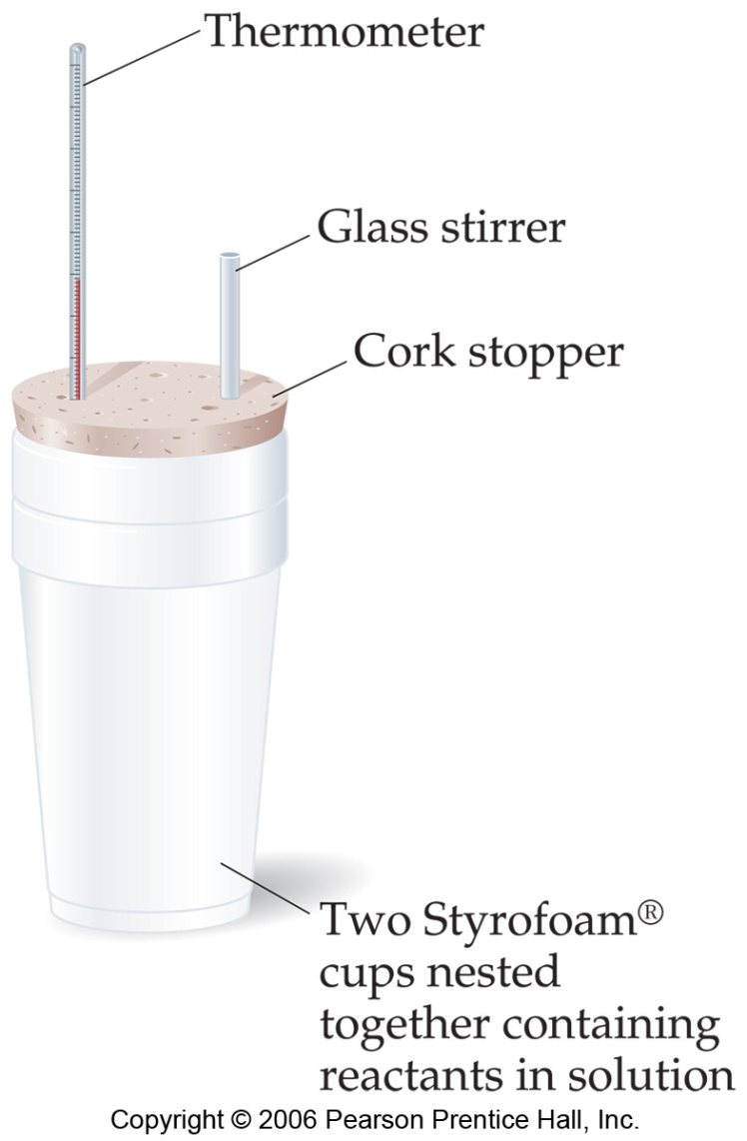
Constant Pressure Calorimetry
By carrying out a reaction in aqueous solution in a simple calorimeter such as this one, one can indirectly measure the ΔH for the system by measuring the heat change for the water in the calorimeter.
q = m × sh × ΔT

Slide 13
Calorimetry
q = m * sh * ΔT
q = Joules of heat
m = total mass in calorimeter
(If a solution, use m = D * V to obtain the mass)
Water has a density of 1.00 g/mL
Most water solutions have a density of 1.02 g/mL
sh = specific heat (for water, 4.18 J/g-K)
ΔT = T_{f} - T_{i}

Slide 14
Calorimetry
Σ q = 0
In other words, the heat released (or absorbed) by the reaction of interest = the sum of the heat gained (or released) by the resulting solution & calorimeter.
q_{calorimeter} + q_{reaction}+ q_{resulting solution} = 0
If we assume q_{calorimeter} is negligible the equation reduces to the following:
q_{reaction} = - q_{solution} = -m*sh*ΔT
where ΔT = T_{f} - T_{i} and m = D * V
ΔH = q_{reaction} /# moles

Slide 15
Specific Heat of a Metal
How to determine specific heat of a metal:
1) Mass metal
2) Put metal in HOT water & measure initial temp of hot metal
3) Measure temp of 100.0 mL (100.0 g) of COLD water
4) Put hot metal in cold water
5) Record temp of water with metal in it (that temp is the final temp for both the metal & water)
6) Calculate the sh of the metal
(m * sh * ΔT)_{metal} = (m * 4.18 * ΔT)_{water}

